Slide 1
3rd Comenius Project Meeting
In Schwamlmstadt (Germany) June 2013

Slide 2
Tuesday, 4th June 2013

Slide 3
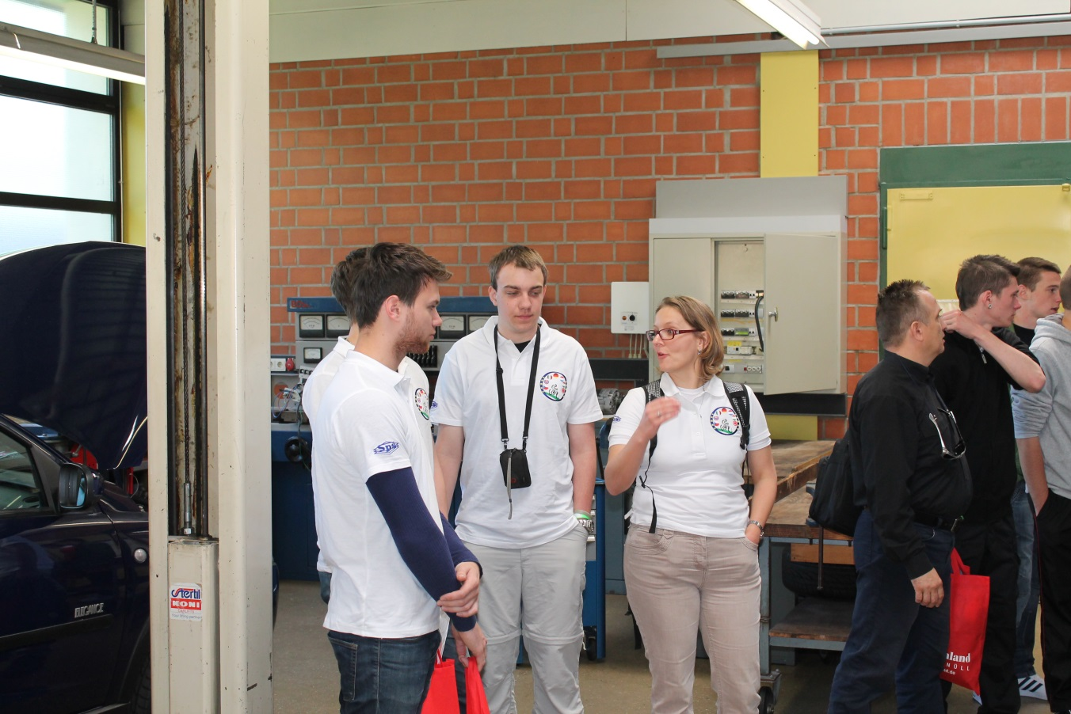
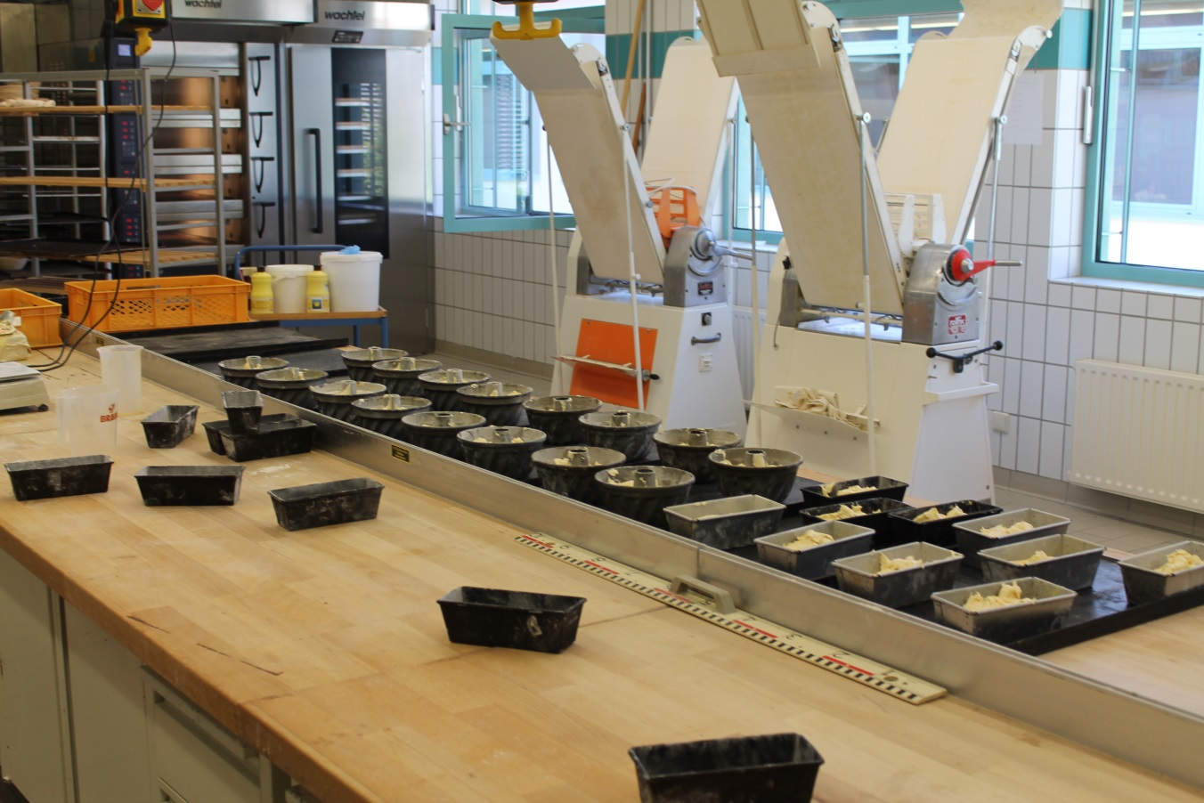
School visits

Slide 4
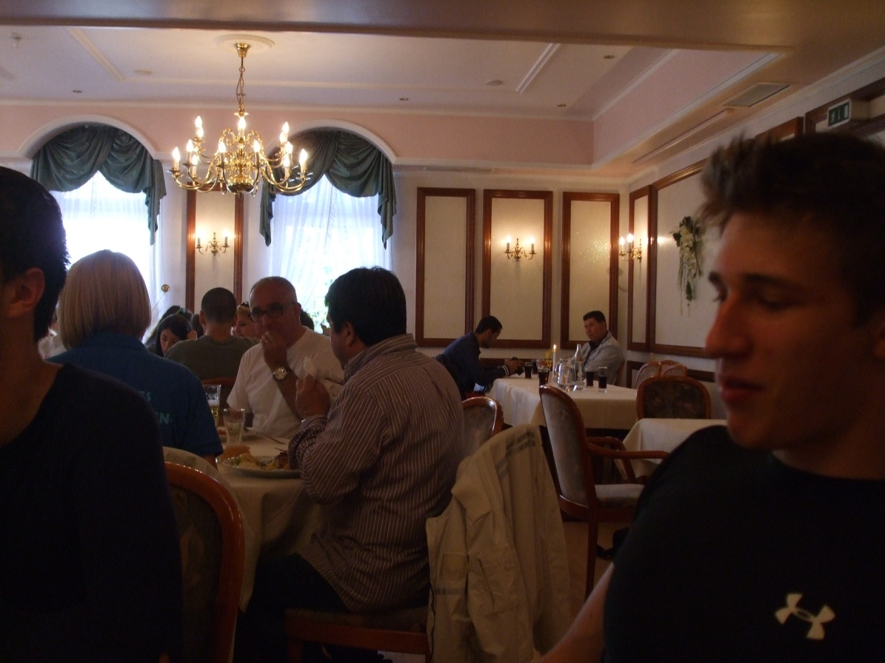
Lunch in restaurant

Slide 5
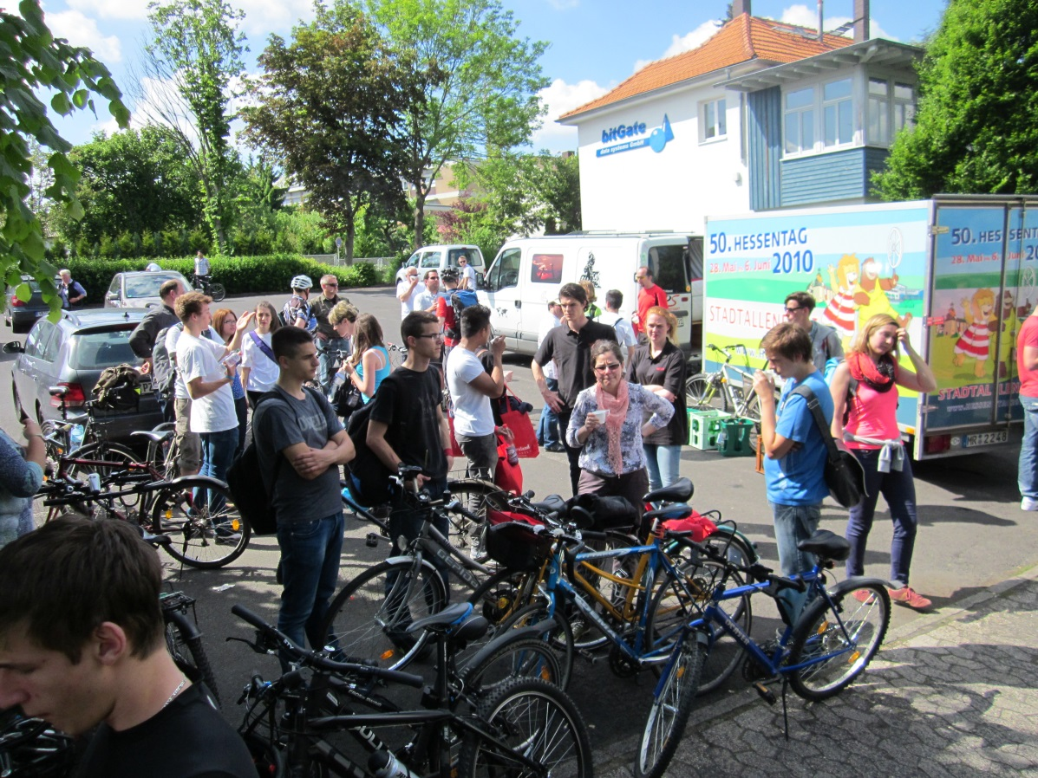
Cycling

Slide 6
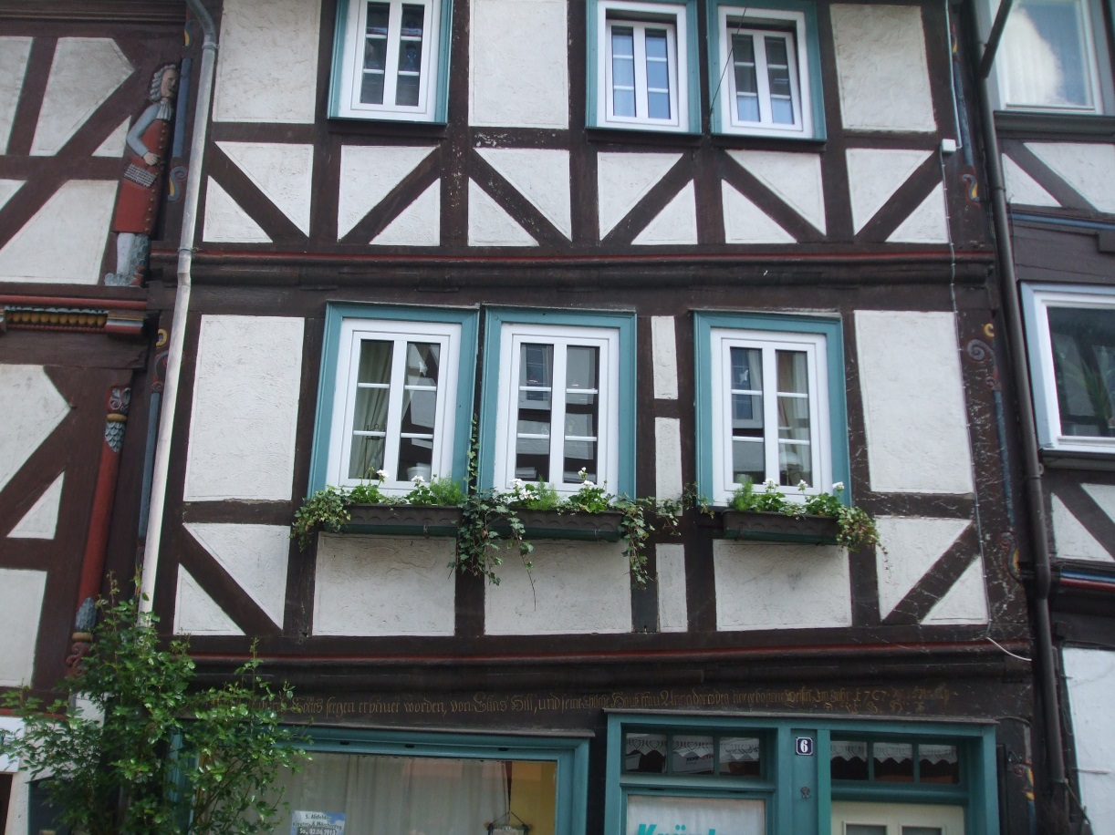
Alsfeld

Slide 7
Wednesday, 5th June 2013

Slide 8
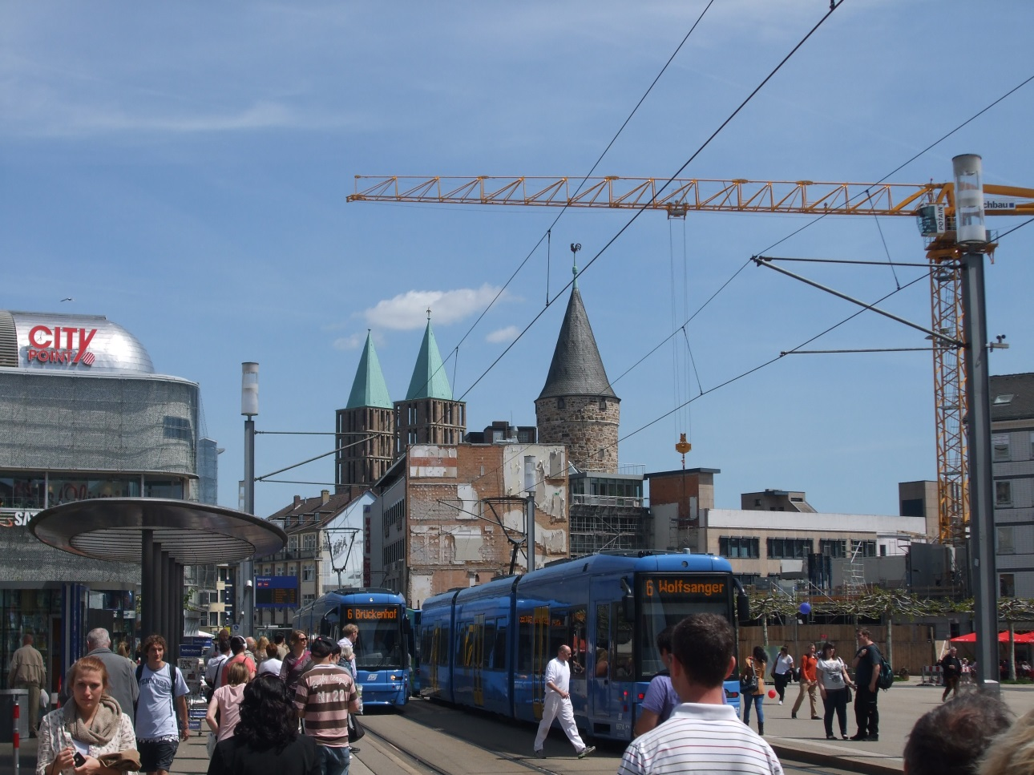
Kassel

Slide 9
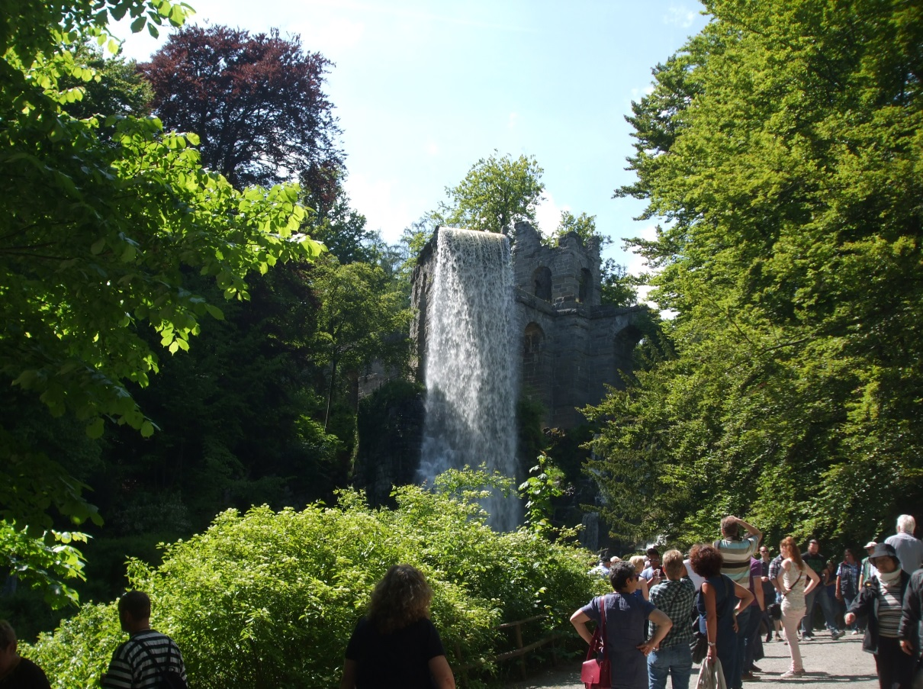
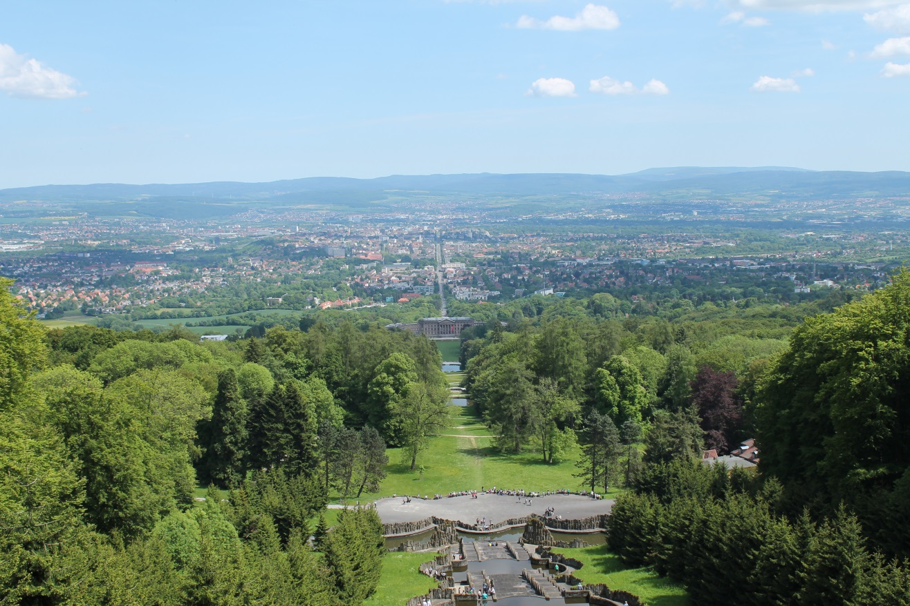
„Herkules“ in Kassel

Slide 10
Thursday, 6th June 2013

Slide 11
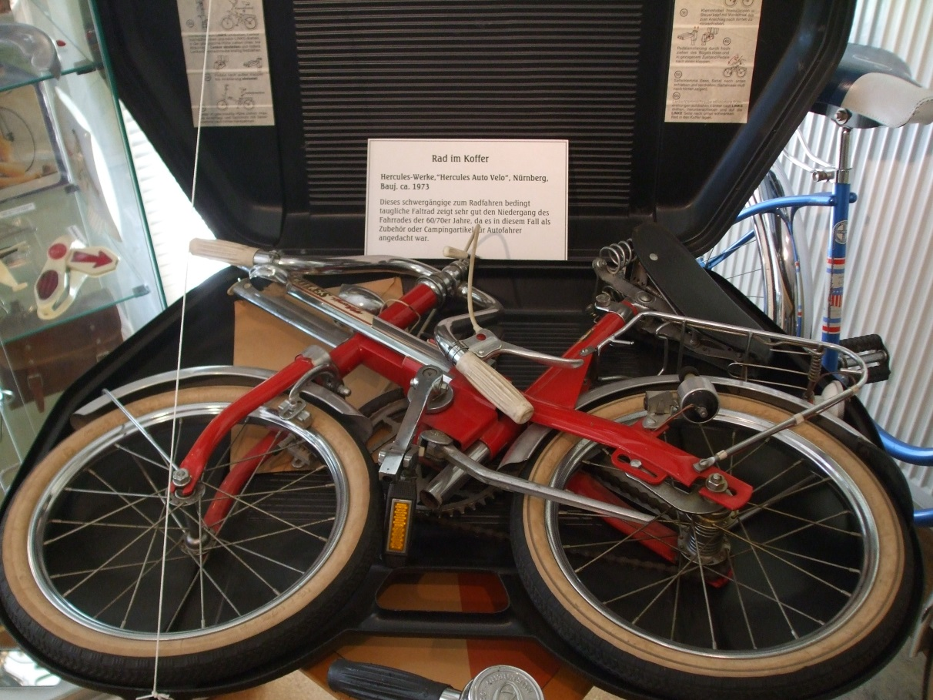
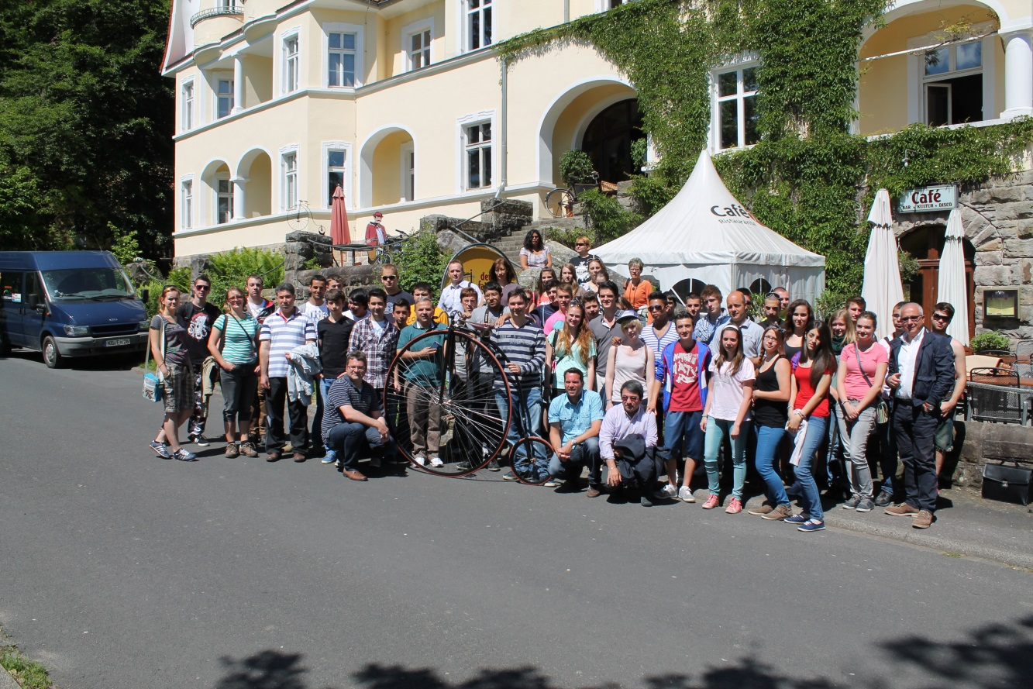
Cycling Museum in Bad Brückenau

Slide 12
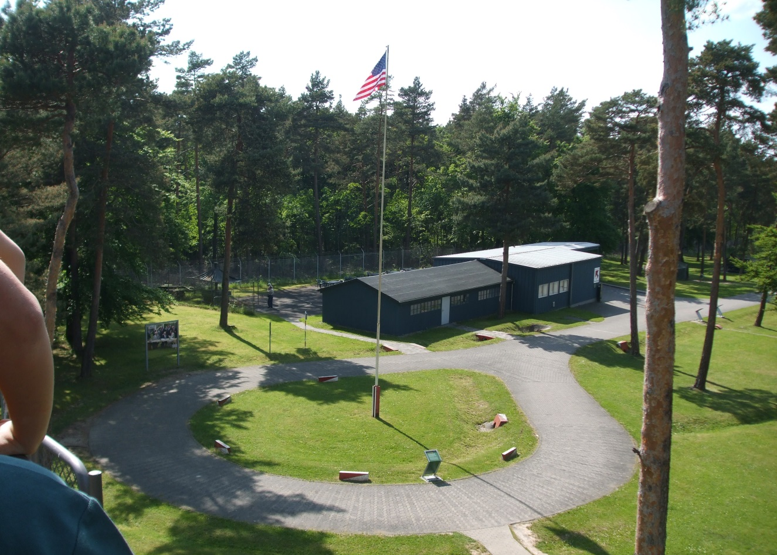
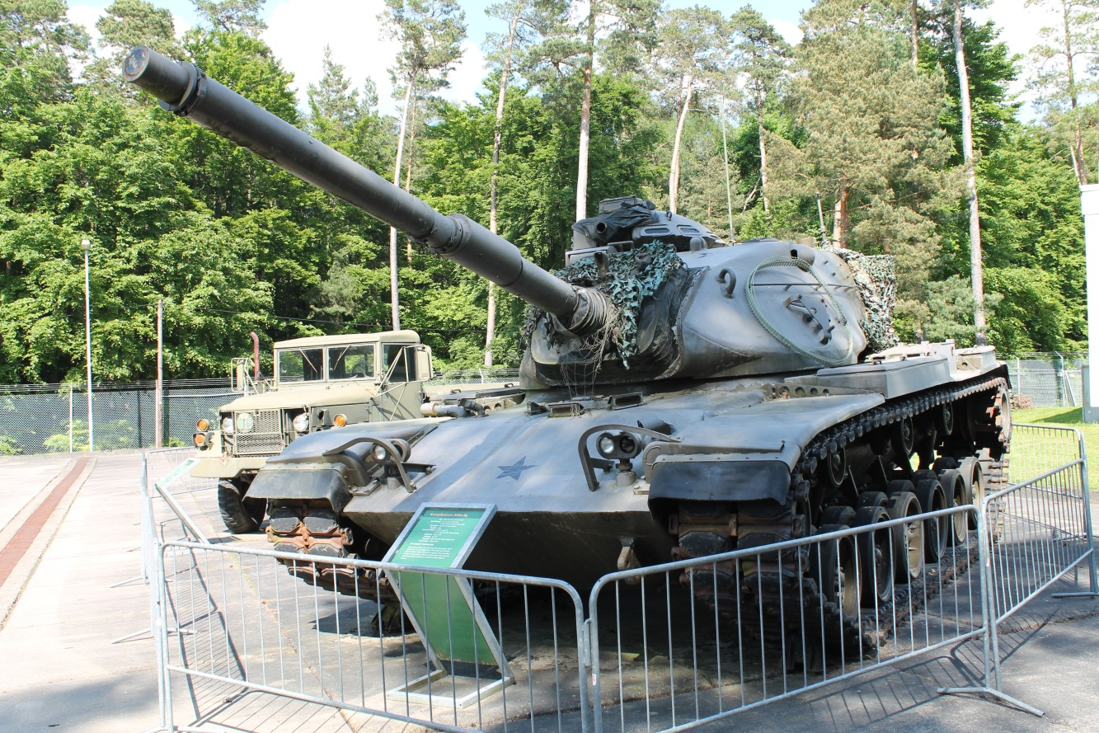
Point Alpha

Slide 13
Thank you very much for your attention and enjoy this meeting.

