Slide 1

Comenius
Netherlands

Slide 2
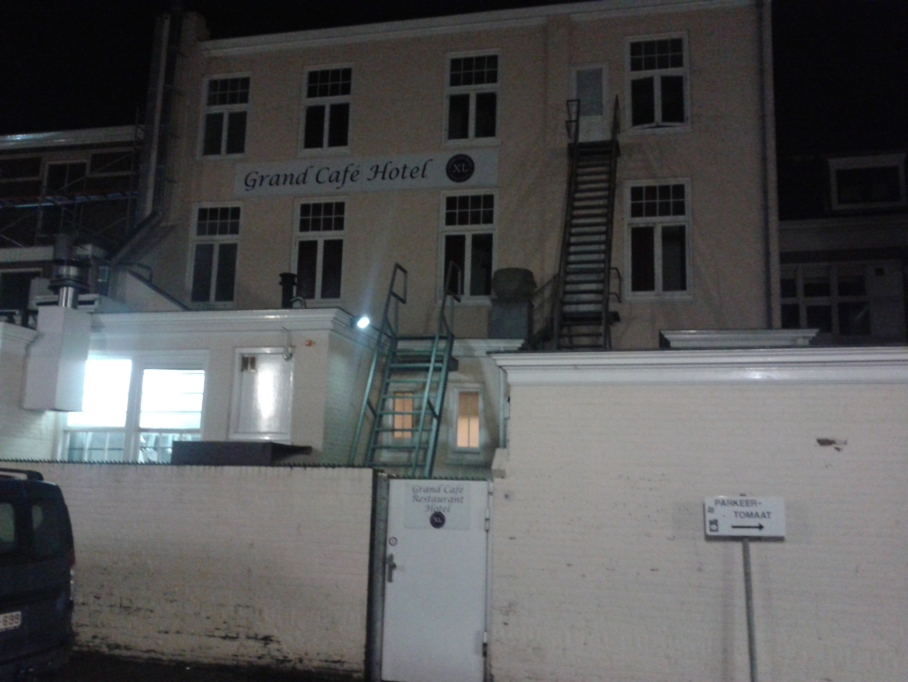
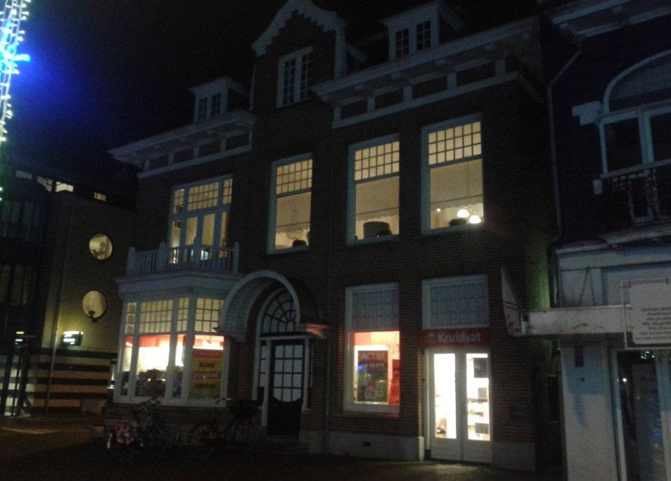

Monday
Journey to Netherlands
(about 10 hours of ride)
Accomodation in hotel„XL“
Tour through the Zaandvort in the evening

Slide 3
Tuesday
Tuesday was dedicated to a bike tour (it was pouring whole day)
We went to a school ROC van Amsterdam from hostel StayOkay.
After the school excursion we went to Museum de Cruquis which was nearby.

Slide 4
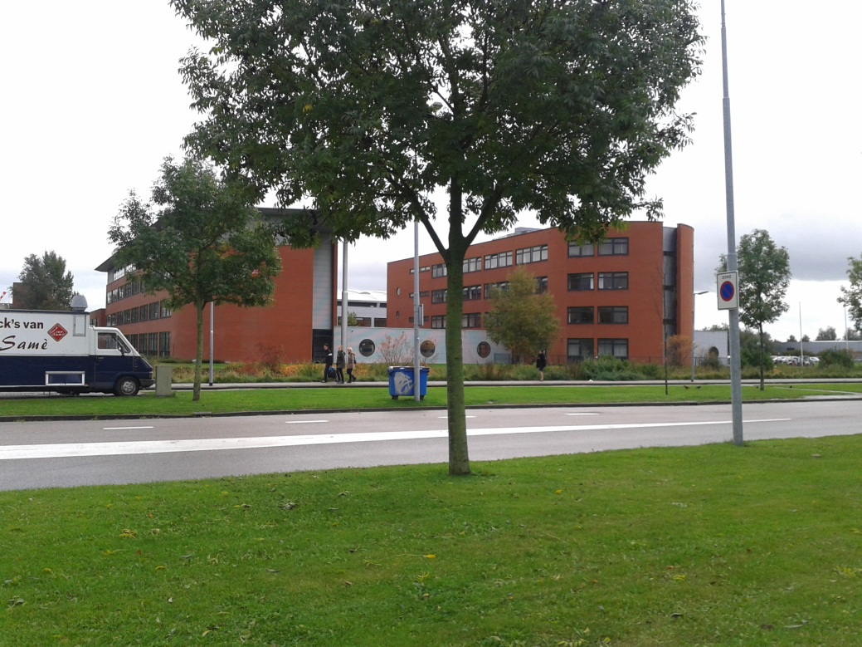
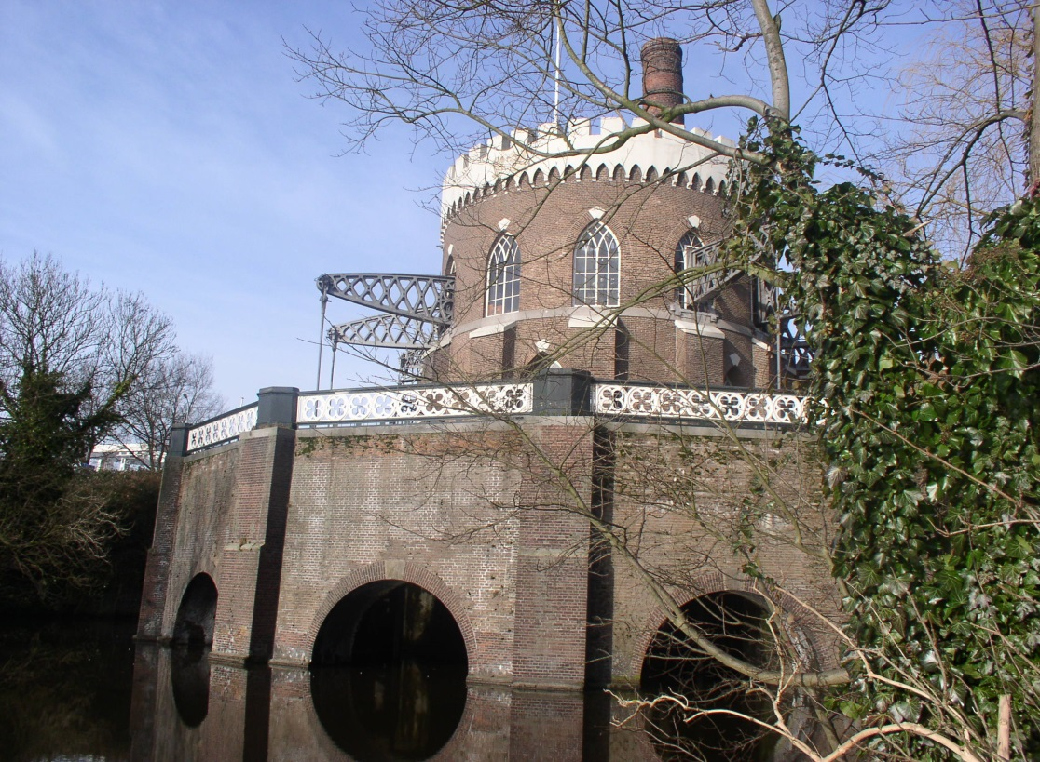
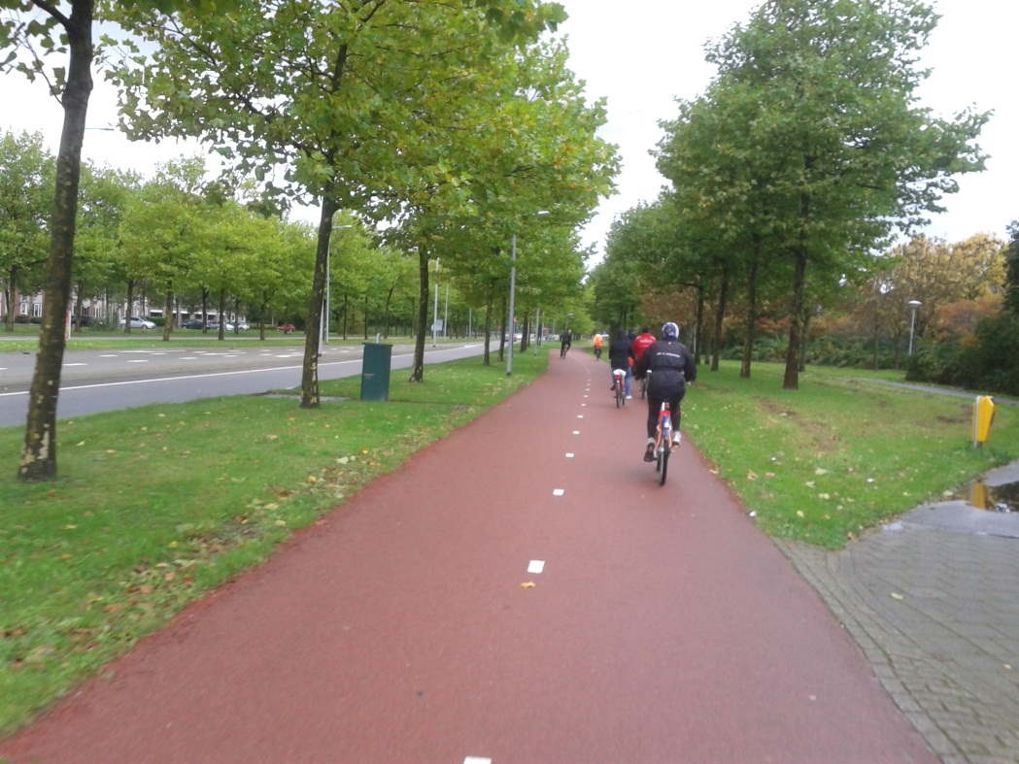
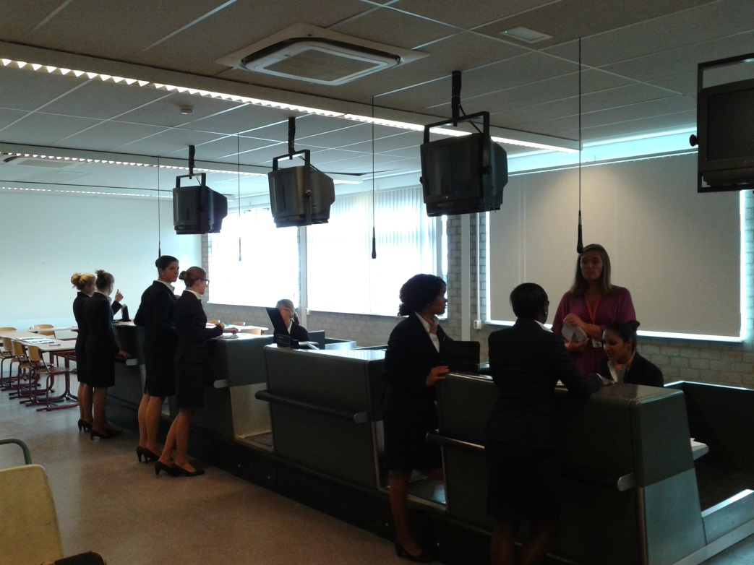

Slide 5
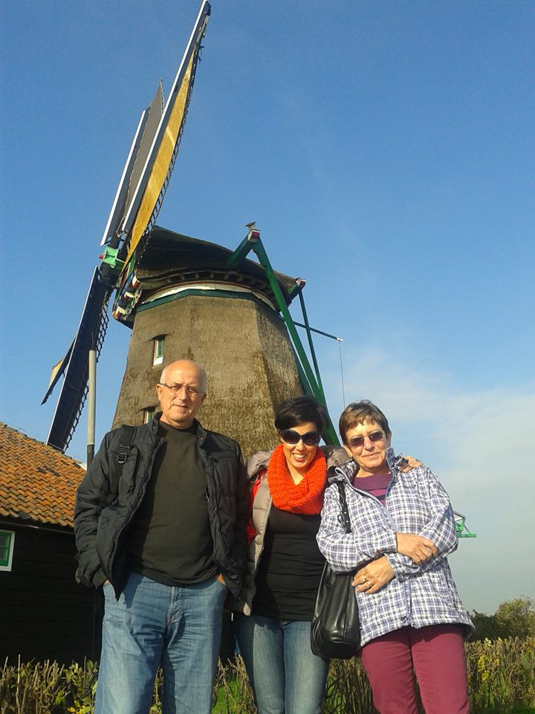
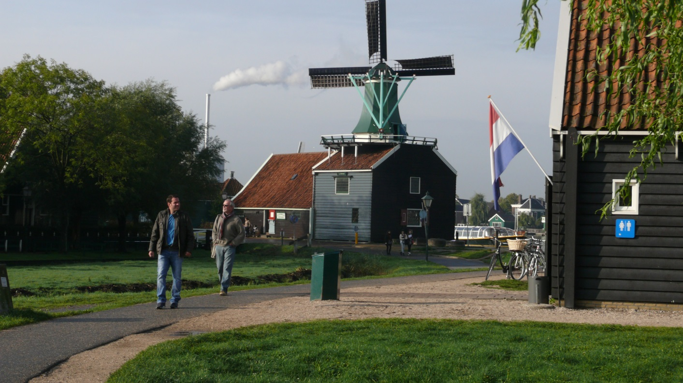
Wednesday
Wednesday was dedicated for a trip to Zaanse Schanz
- Zaanse Schans is an historical village (muzeum)
documenting one of the oldest factory region in Europe.

Slide 6
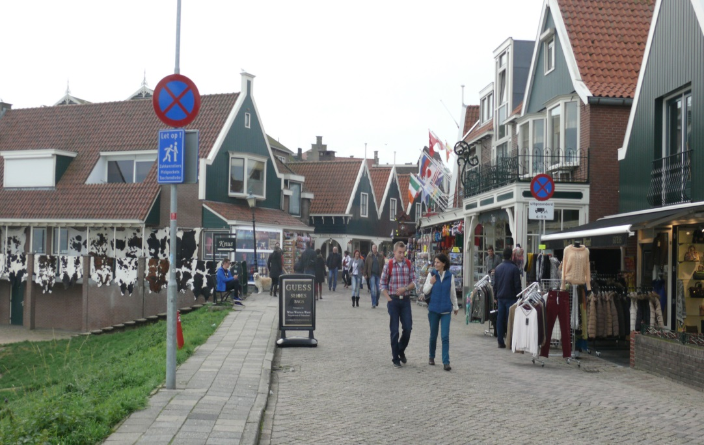
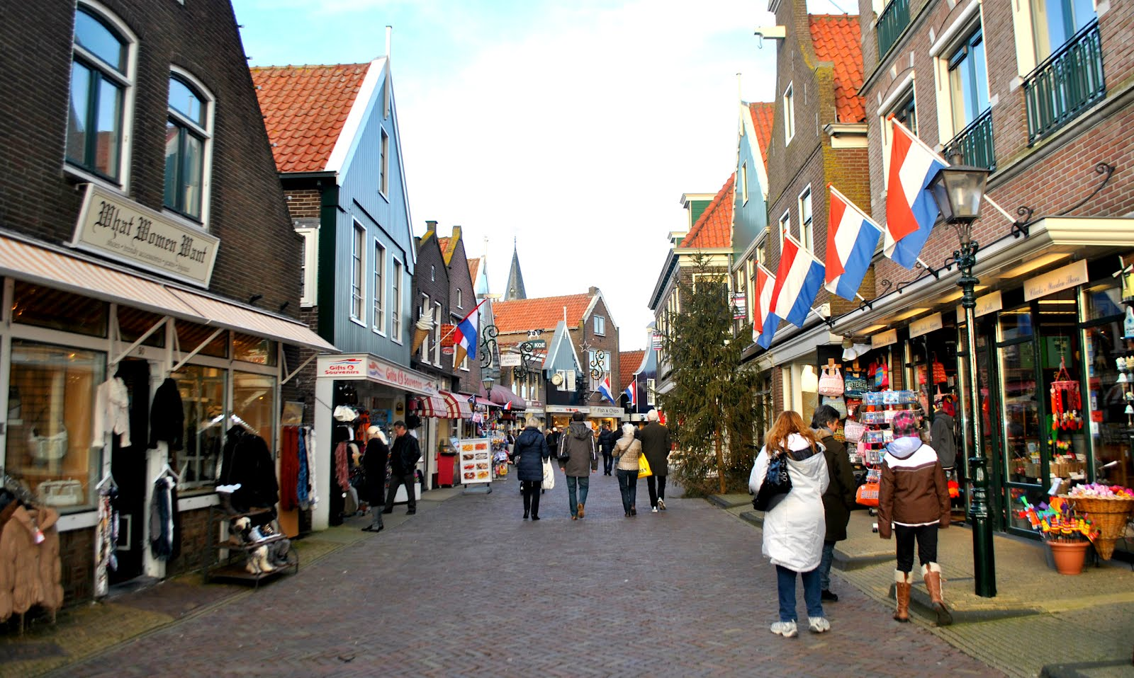
Then we went to a close city named Volendam, where we had Fish and Chips lunch.
And then we had some time for shoping…
And then we went to Edam…

Slide 7
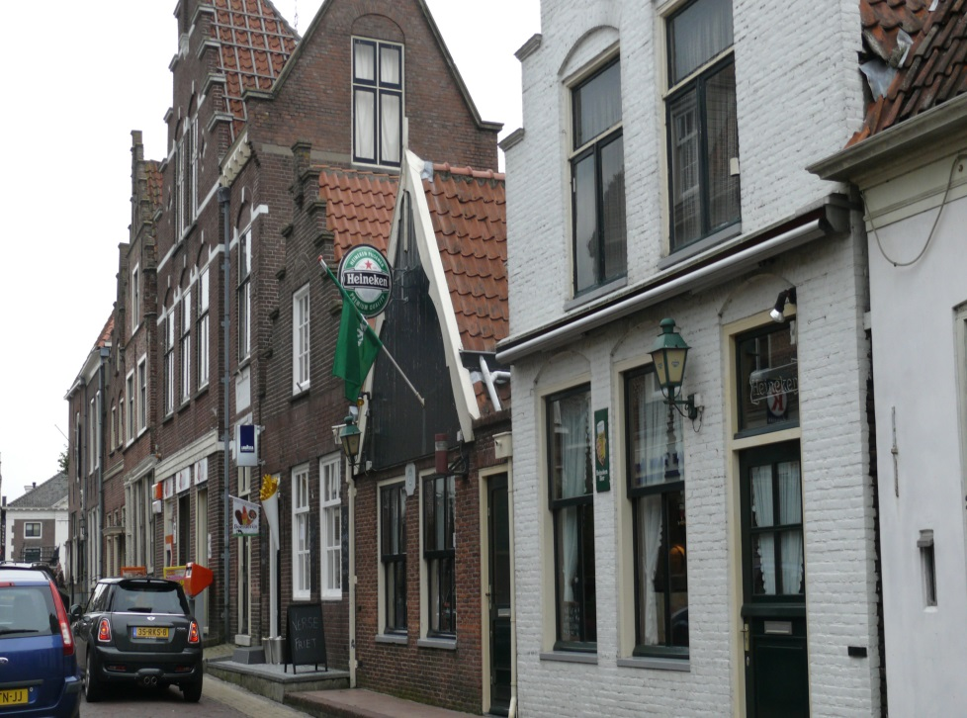
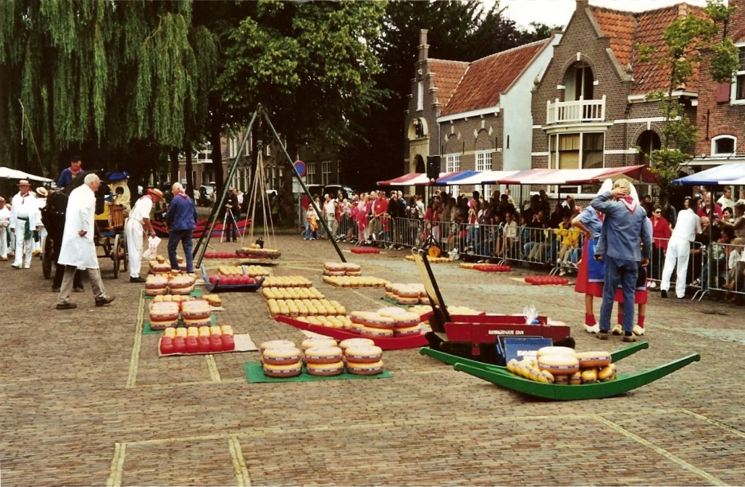
Edam
In Edam we had about one hour for city excursion.
The city gave a name to a local cheese Edam.

Slide 8
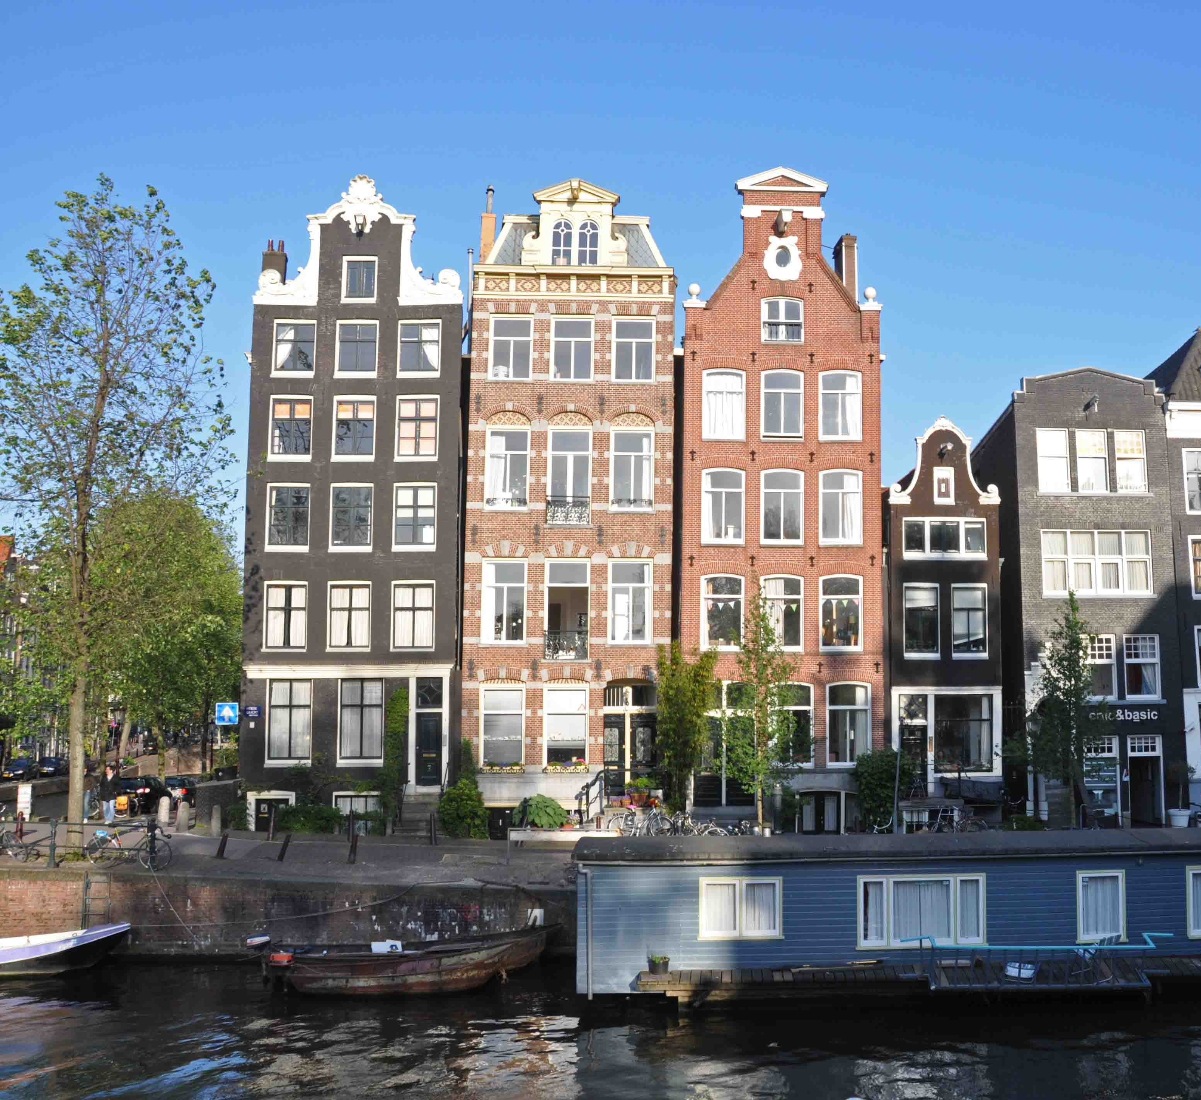
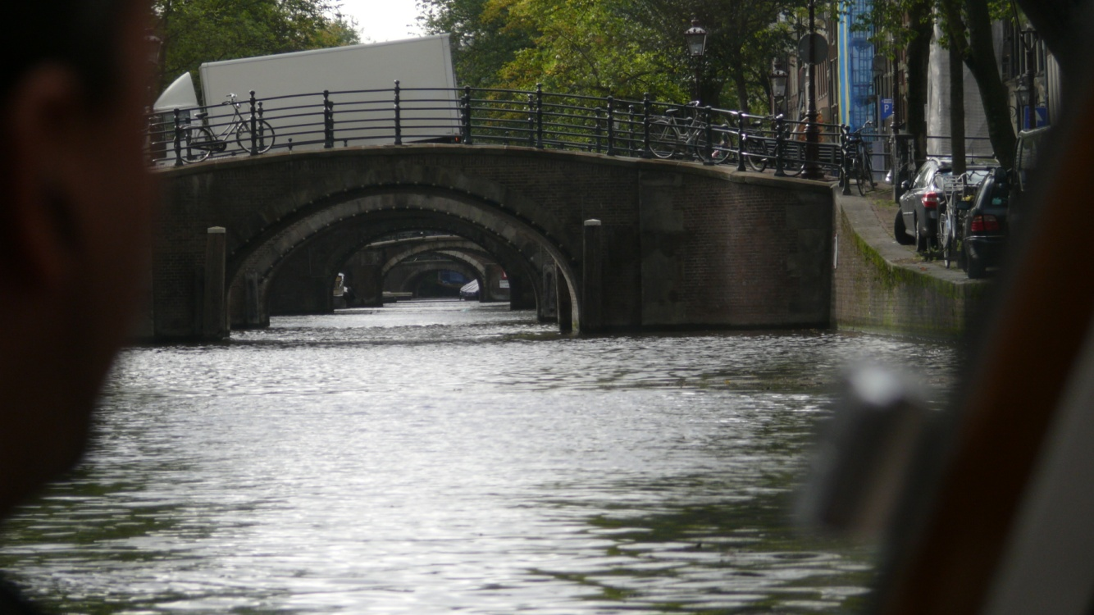
Thursday
Amsterdam !
In Amsterdam we were on a sightseeing boat trip trough Amsterdam canals.

Slide 9
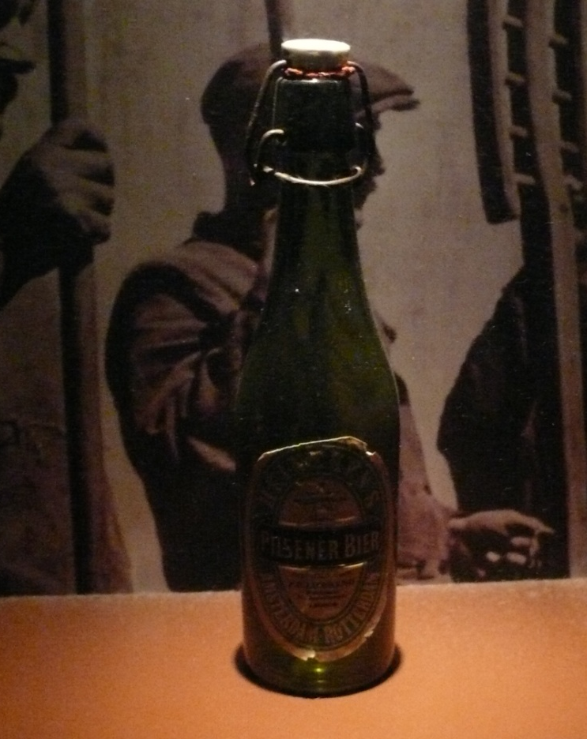
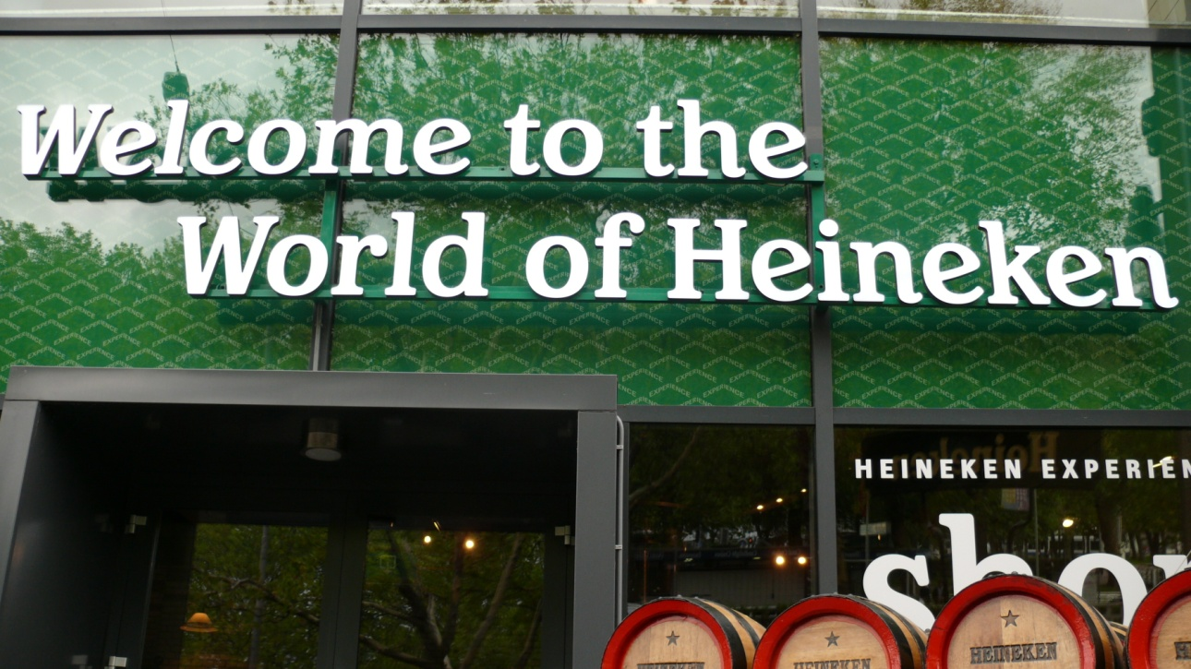
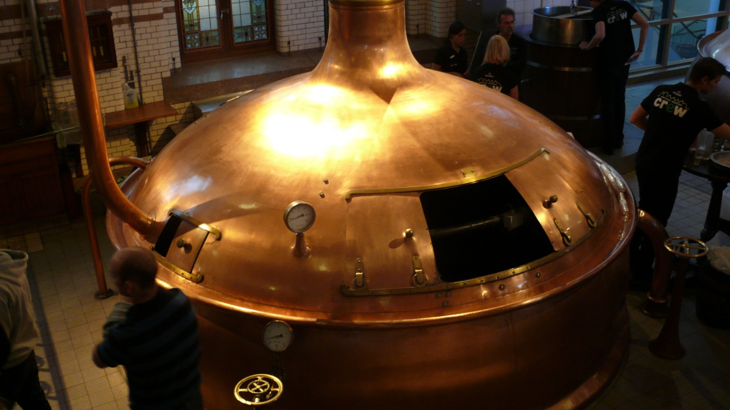
After the boat trip we had time for excursion trough the Amsterdam centre, the excursion ended in popular brewery Heineken.

Slide 10
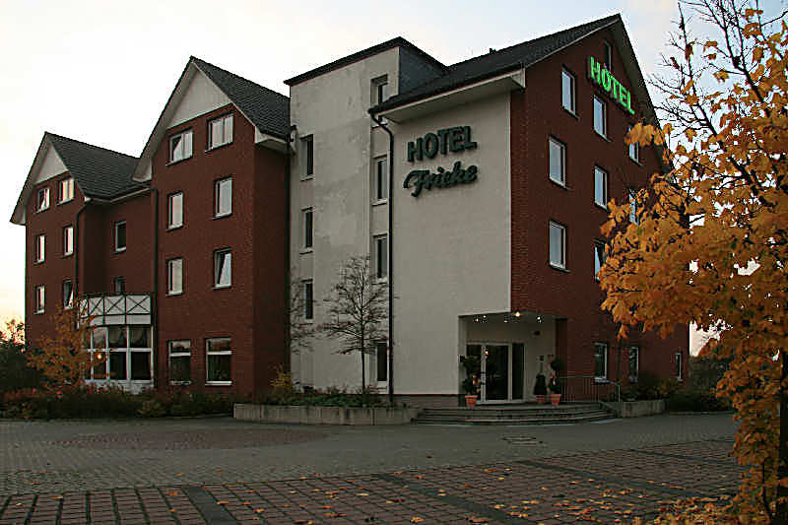
Friday
Tour from Netherlands to Germany.
In germany one night accomodation in Hotel Fricke.

Slide 11
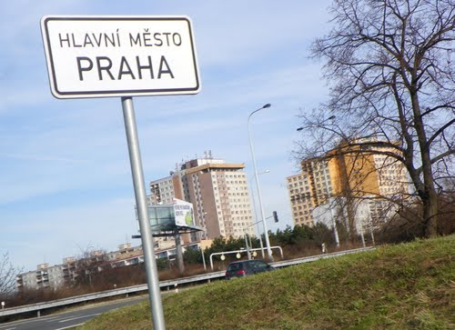
Saturday
Arrive from Germany to Prague!

